Slide 1
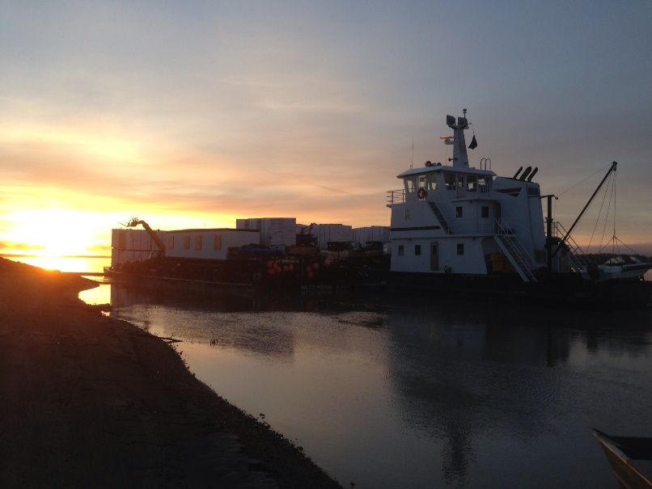
CONTRACTOR’S CASE STUDY
Brice Incorporated – Galena Campion Road

Slide 2
Company Profile
Presenter Information
General Contractor in AK since 1961
Family owned until 2010
Calista Corporation
Current Organizational Structure

Slide 3
Brice Incorporated – Heavy Civil
Based in Fairbanks, AK
150-200 Full-time employees in peak season
Remote, logistically challenging project specialists
Blend of public and private clients

Slide 4
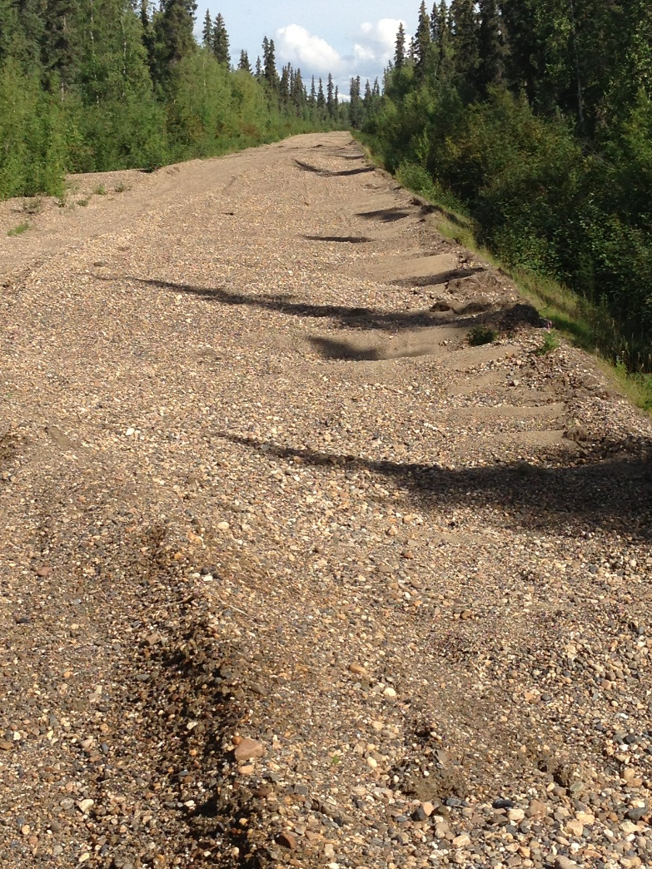
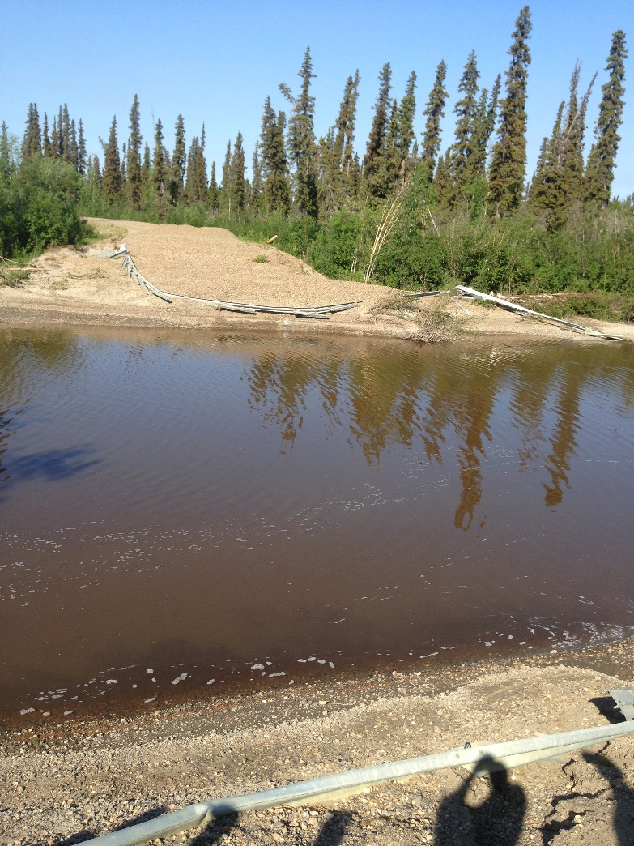
Galena Campion Road Case Study
Project overview
Schedule
Flooding in Spring 2013 and other challenges

Slide 5
Sustainability Aspects
Local hire
Local resource utilization
Disaster response
Clearing
Permafrost protection
Coordination with other community projects
Project specification “upgrades”
Agency coordination

Slide 6
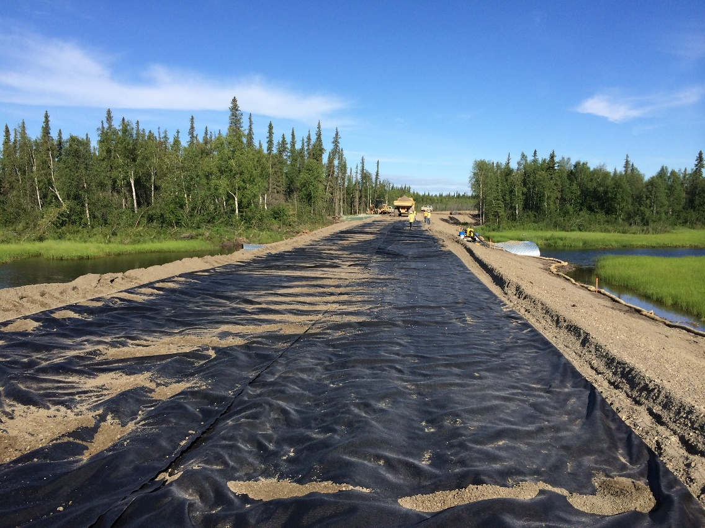
Local Hire / Resource Utilization
Reduces crew mobilization costs
Reduces housing costs and footprint
Reduces equipment mobilization costs
Increases impact to local economy
Cannot be blind local utilization!

Slide 7
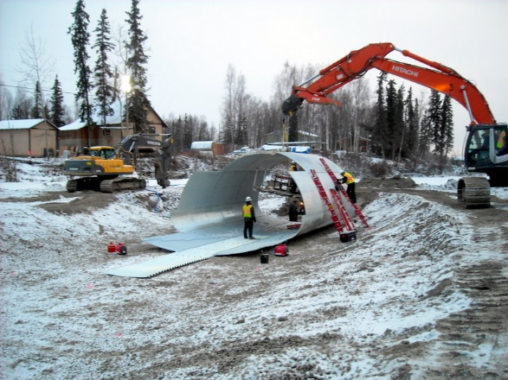
Disaster Response and Agency Coordination
Infrastructure needed to complete original contract
Haul routes
Housing
Permitting
Quantity constraints
Methodology constraints
Dynamic modification

Slide 8
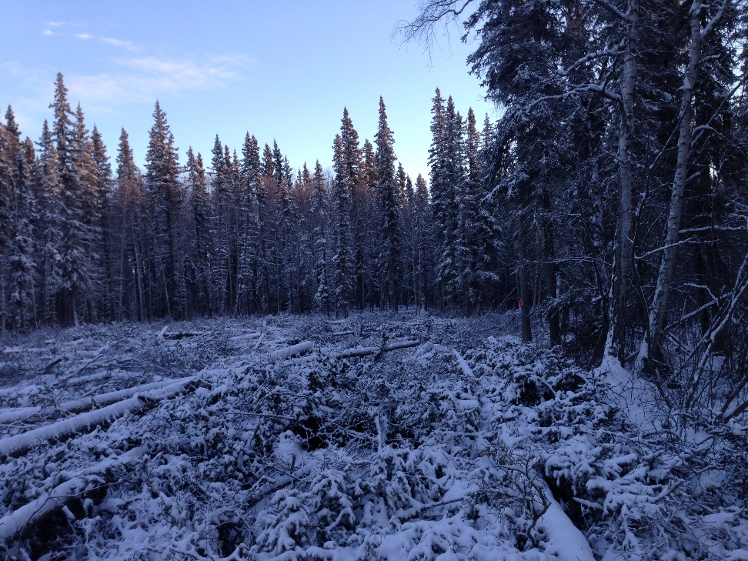
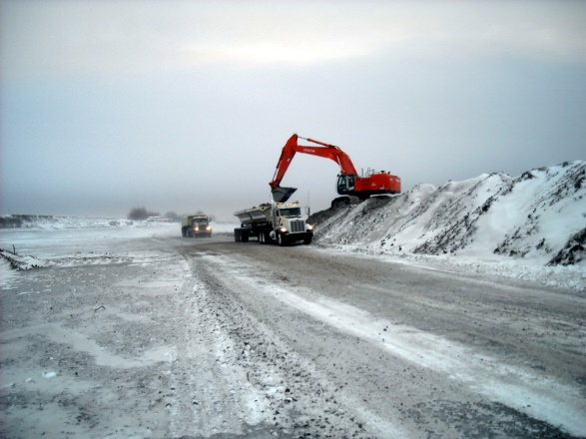
Clearing / Permafrost Protection
Scheduling Considerations
Heavy equipment over soft ground
Seasonal frost whiplash curves
Lower efficiency in cold conditions
Utilization of cleared materials
Permit requirement compliance

Slide 9
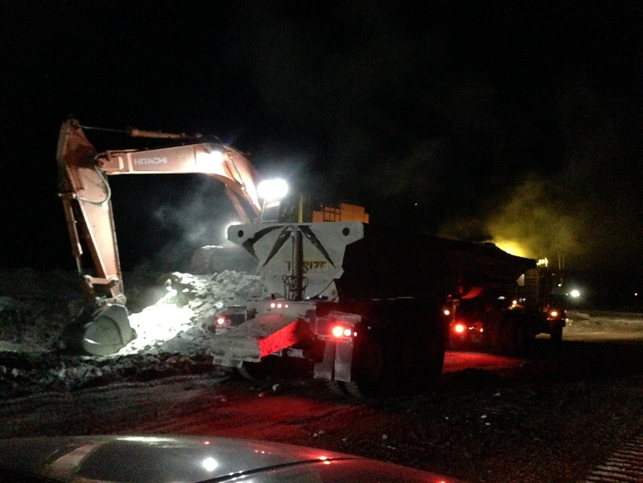
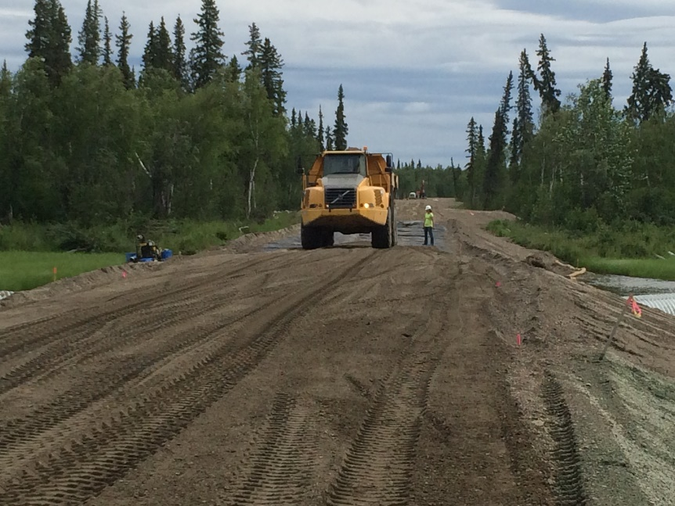
Project Synergies and Specification “Upgrades”
Reduced mobilization costs
Condensed schedules
Increased local hire utilization
Feedback to design engineers on goals of project and specifications
Constructability reviews

Slide 10
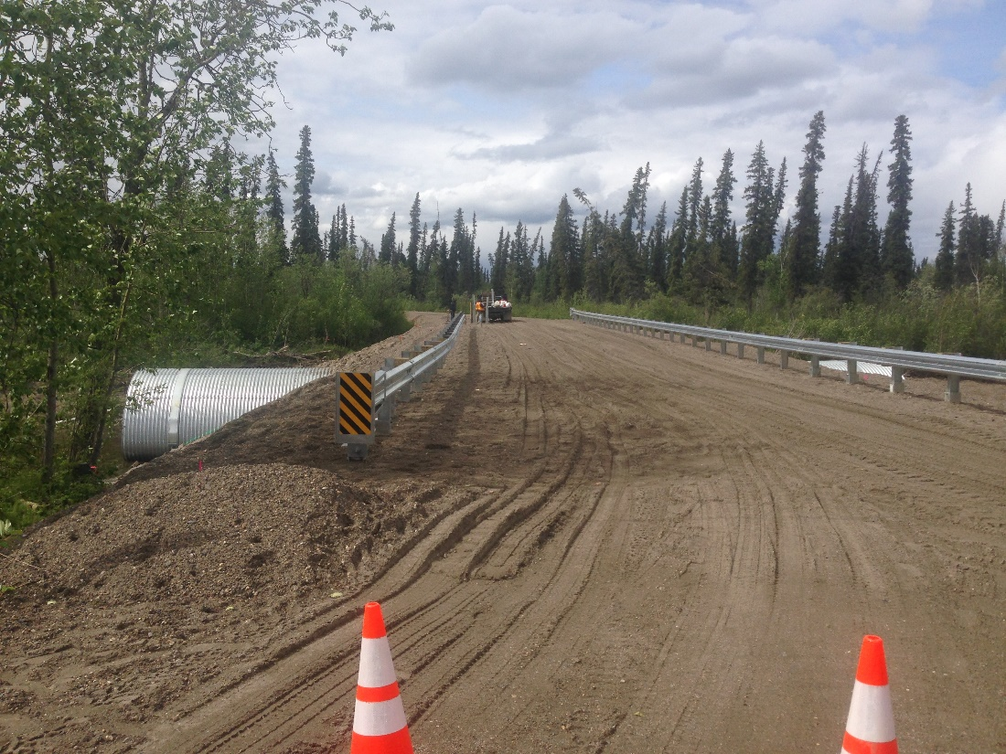
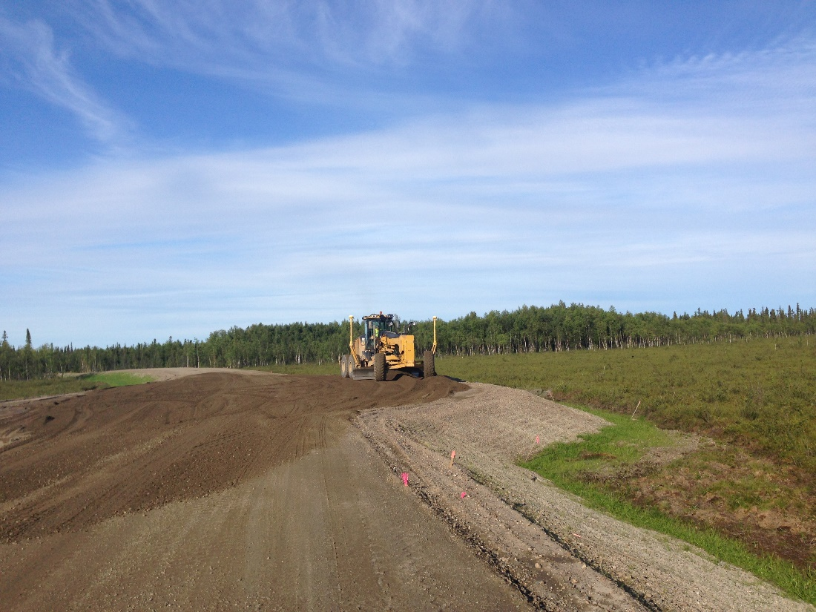
Questions?

